Slide 1

Graduate Rotational Internship Program The Sparks Foundation
By: Y.Srikar
Web and mobile development intern
Batch: july21
Task 1

Slide 2
Task List
The task list contains tasks in the following categories:
LinkedIn Profile Improvement (Mandatory for all)
Technology -
Web & Mobile Development.
Non-Tech
Content Development & Digital Marketing

Slide 3
Basic Banking System
Create a simple dynamic website which has the following specs.
Start with creating a dummy data in database for upto 10 customers. Database options: Mysql, Mongo, Postgres, etc. Customers table will have basic fields such as name, email, current balance etc. Transfers table will record all transfers happened.
Flow: Home Page > View all Customers > Select and View one Customer > Transfer Money > Select customer to transfer to > View all Customers .
Host the website at 000webhost, github.io, heroku app or any other free hosting provider. Check in code in gitlab.

Slide 4
Details Of my Project Name : SPARKS Bank
Name and logo have been chosen randomly.
Images are supposed to be copyright free even on cases otherwise, no copyright intended.
This project covers all that had been asked for and some additional add-ons as well.
Front end – HTML5, CSS, Bootstrap
Back end – PHP and JavaScript
Database used – MySQL
Server Facility – XAMPP (IP/localhost : 127.0.0.1:8080)

Slide 5
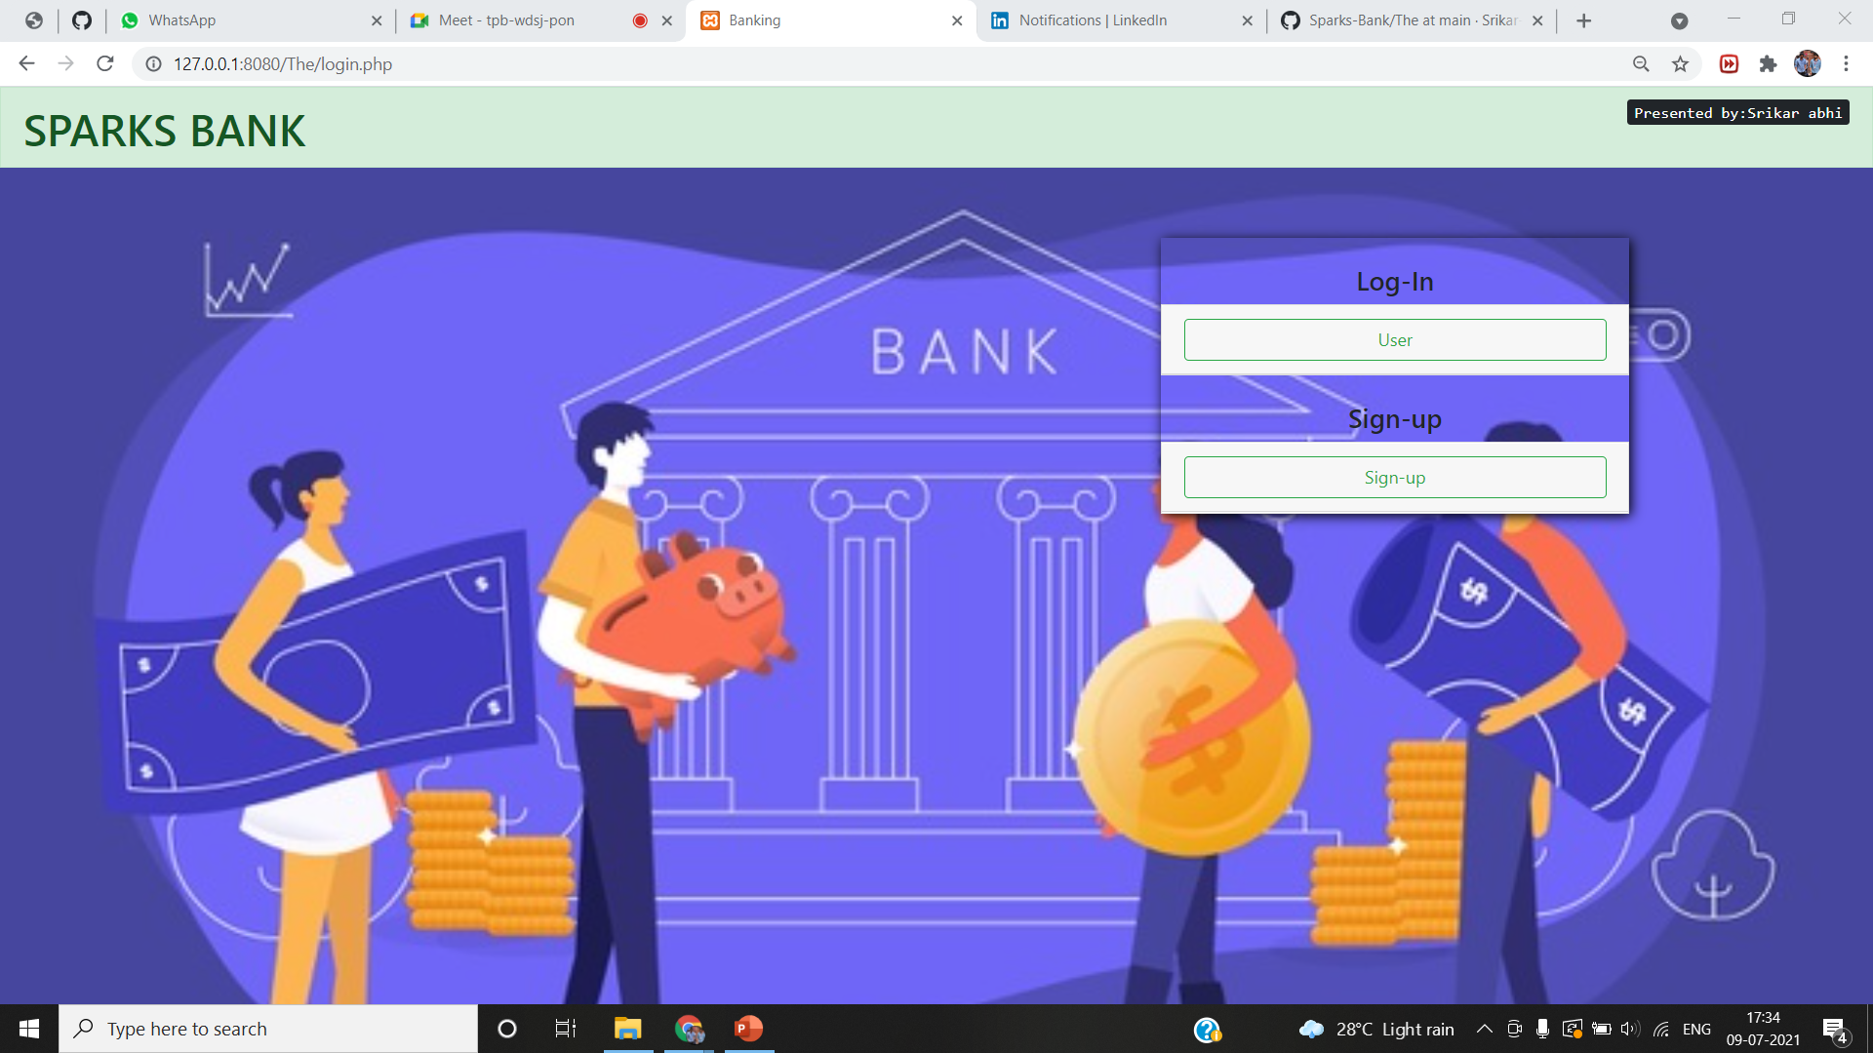
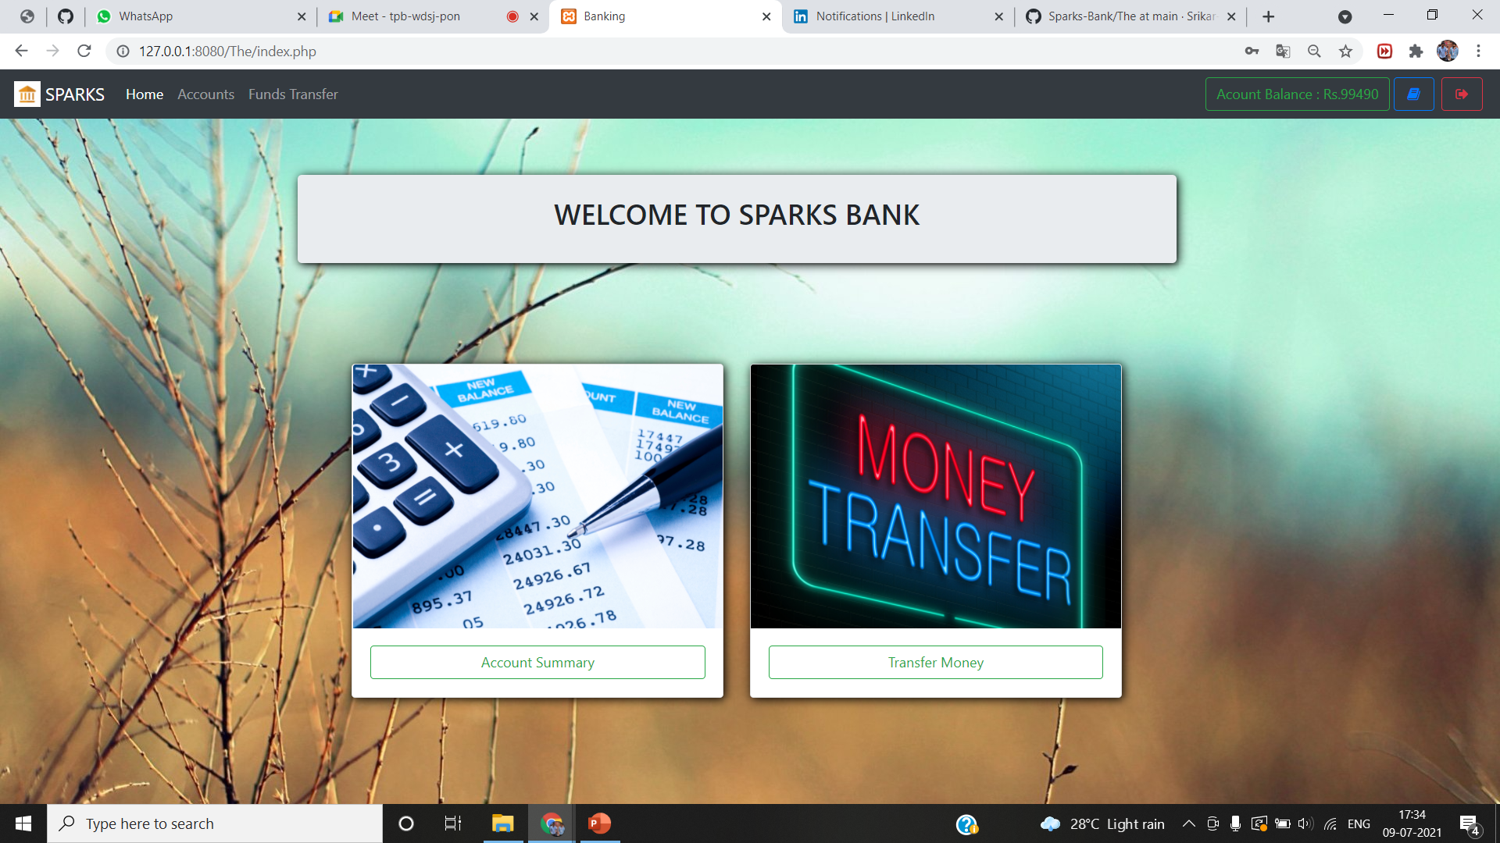
OUTPUT:

Slide 6
Accessibility of my project
Download the project from :https://github.com/Srikar-abhi-ram/Sparks-Bank
YouTube link:

Slide 7
THANK YOU

